Slide 1

Empirical Asset Volatility Analysis
$$μ_{i}^{A}$$
James Edwards
April 2018

Slide 2
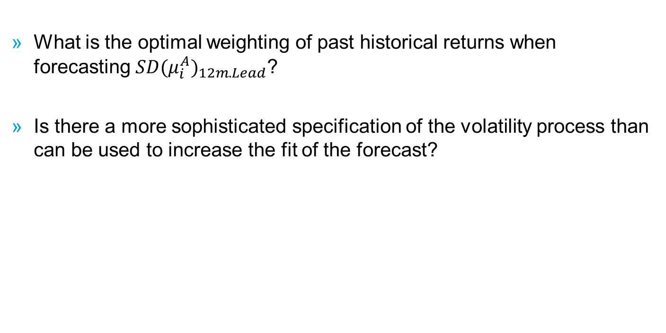
Research Questions
  What is the optimal weighting of past historical returns when forecasting ${SD(μ_{i}^{A})}_{12m.Lead}$?
  Is there a more sophisticated specification of the volatility process than can be used to increase the fit of the forecast?

Slide 3
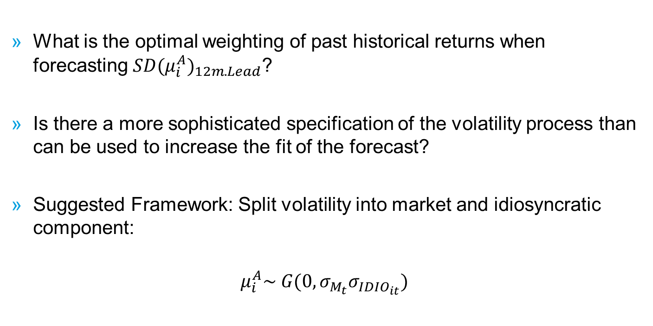
Research Questions
  What is the optimal weighting of past historical returns when forecasting ${SD(μ_{i}^{A})}_{12m.Lead}$?
  Is there a more sophisticated specification of the volatility process than can be used to increase the fit of the forecast?
  Suggested Framework: Split volatility into market and idiosyncratic component:
  $$μ_{i}^{A}\sim G(0,σ_{M_{t}}σ_{{IDIO}_{it}})$$

Slide 4
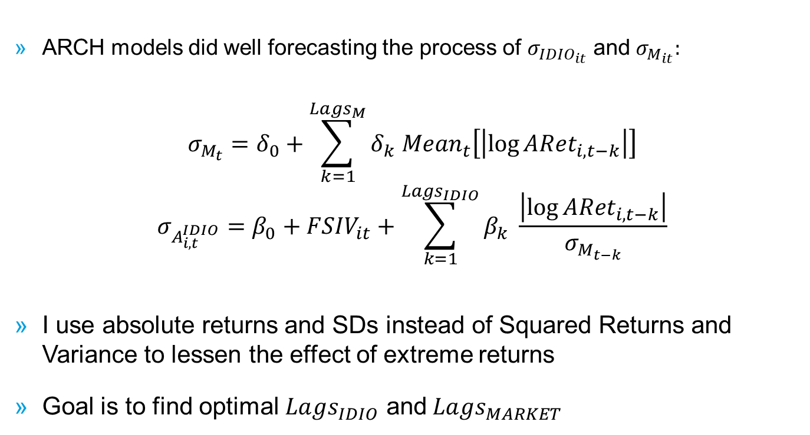
ARCH(q) Models
  ARCH models did well forecasting the process of $σ_{{IDIO}_{it}}$ and $σ_{M_{it}}:$
  $$σ_{M_{t}}=δ_{0}+\sum_{k=1}^{La{gs}_{M}}{δ_{k}{ Mean}_{t}\left[\left|\log{{ARet}_{i,t−k}}\right|\right]}$$
  $$σ_{A_{i,t}^{IDIO}}={β_{0}+FSIV}_{it}+\sum_{k=1}^{La{gs}_{IDIO}}{β_{k} \frac{\left|log⁡{ARet}_{i,t−k}\right|}{σ_{M_{t−k}}}}$$
  I use absolute returns and SDs instead of Squared Returns and Variance to lessen the effect of extreme returns
  Goal is to find optimal $La{gs}_{IDIO}$ and$La{gs}_{MARKET}$

Slide 5
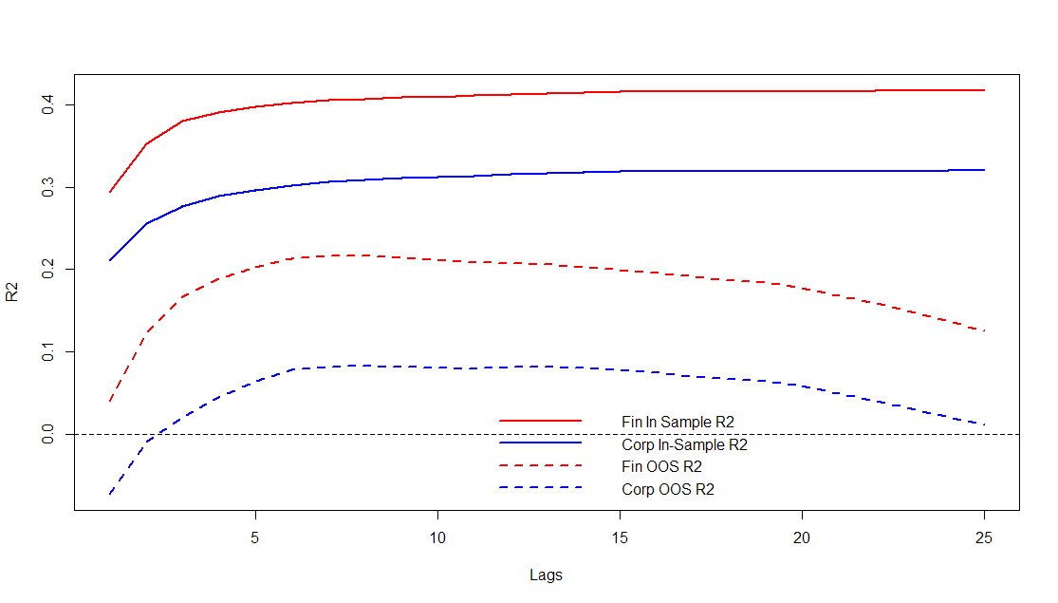
ARCH(q) Market Model Fits
  The optimal number of lags is LAGS=8 for both Financials and Corporates

Slide 6
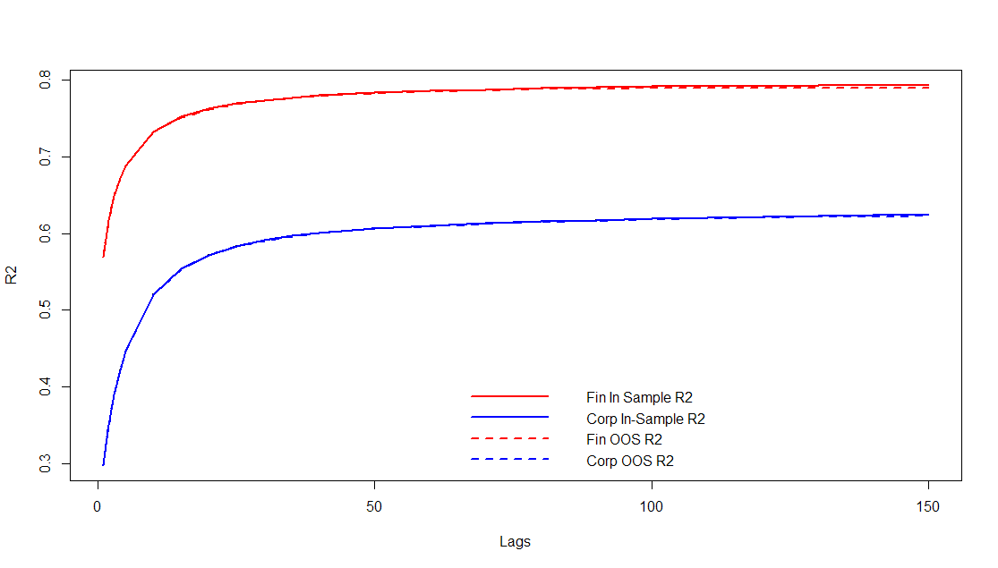
ARCH(q) Idiosyncratic Model Fits
  The optimal number of lags is 120 for Financials and 150 (or more?) for Corporates

Slide 7
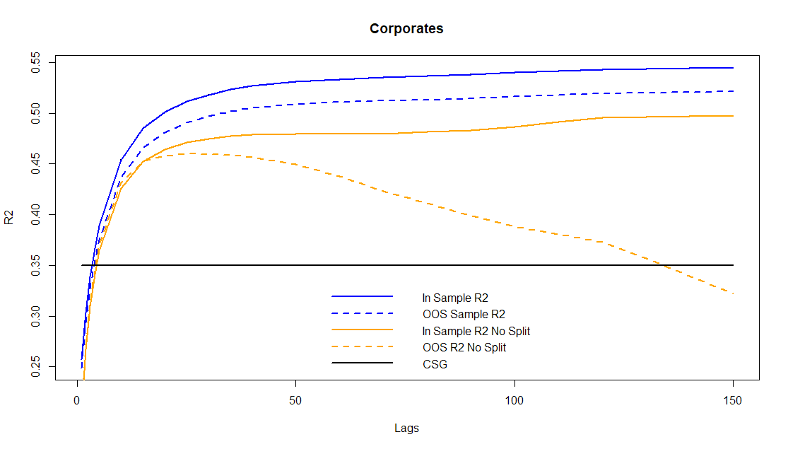
ARCH(q) Combined Model Fits: CORP
  Combining the Idiosyncratic estimates with the Lag=8 Market Model, the fit is improved vs our current volatility estimate and non-split specifications

Slide 8
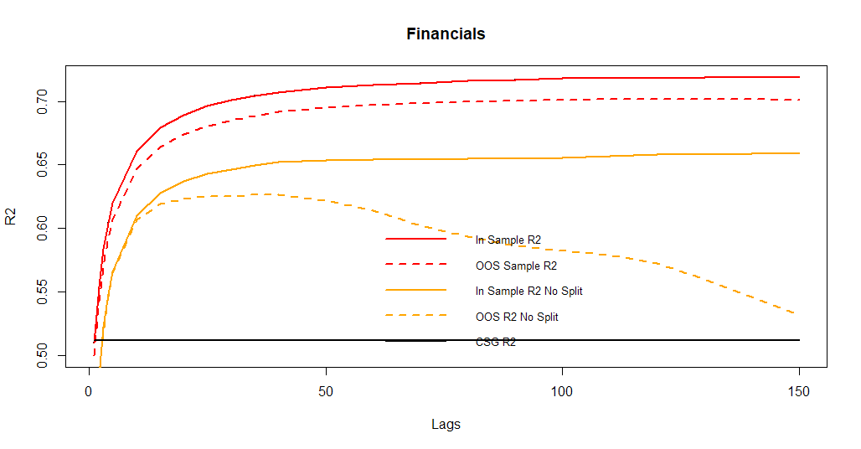
ARCH(q) Combined Model Fits: FIN
  Combining the Idiosyncratic estimates with the Lag=8 Market Model, the fit is improved vs our current volatility estimate and non-split specifications

Slide 9
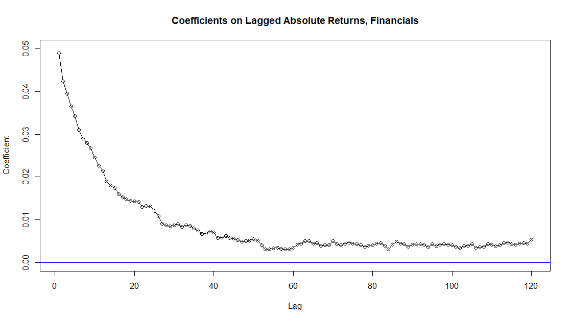
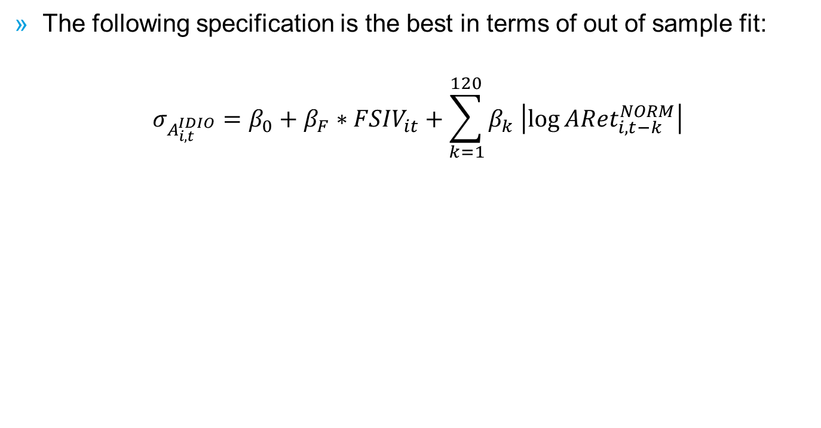
Simplifying Idosyncratic ARCH model
  The following specification is the best in terms of out of sample fit:
  $$σ_{A_{i,t}^{IDIO}}={β_{0}+β_{F}∗FSIV}_{it}+\sum_{k=1}^{120}{β_{k} \left|log⁡{ARet}_{i,t−k}^{NORM}\right|}$$

Slide 10
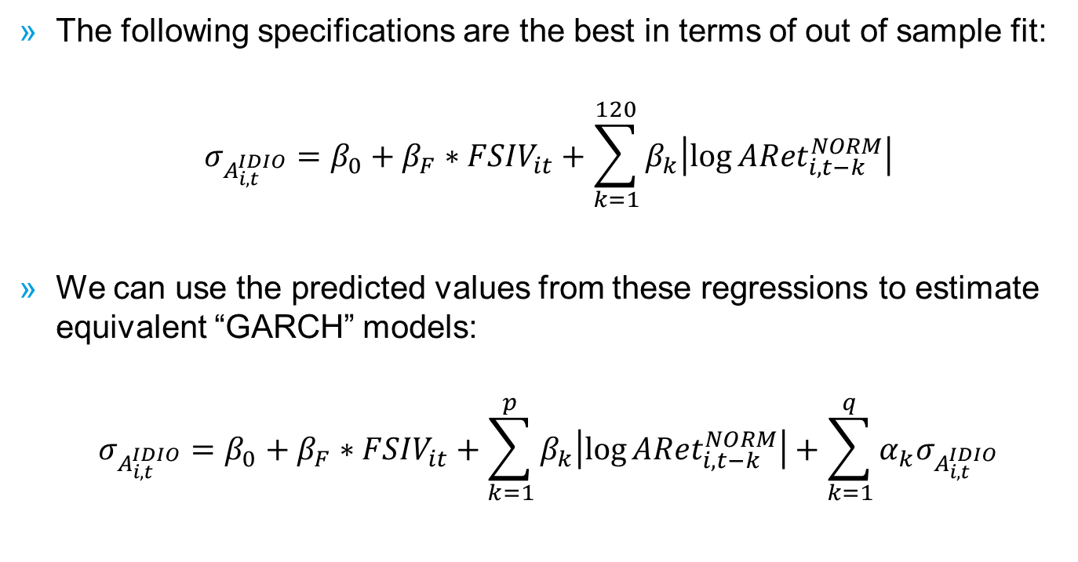
Equivalent GARCH Model
  The following specifications are the best in terms of out of sample fit:
  $$σ_{A_{i,t}^{IDIO}}={β_{0}+β_{F}∗FSIV}_{it}+\sum_{k=1}^{120}{β_{k}\left|log⁡{ARet}_{i,t−k}^{NORM}\right|}$$
  We can use the predicted values from these regressions to estimate equivalent “GARCH” models:
  $$σ_{A_{i,t}^{IDIO}}={β_{0}+β_{F}∗FSIV}_{it}+\sum_{k=1}^{p}{β_{k}\left|log⁡{ARet}_{i,t−k}^{NORM}\right|}+\sum_{k=1}^{q}{α_{k}σ_{A_{i,t}^{IDIO}}}$$

Slide 11
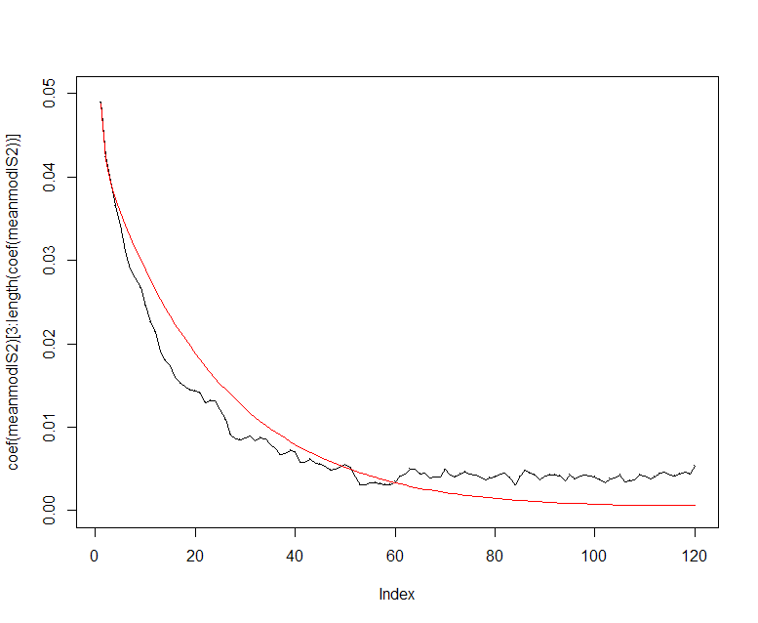
Comparing Coefficients
  Below I plot the ARCH(q) coefficients against those of the ARCH(Inf) implied by the GARCH(2,2) for Financials

Slide 12
Empirical Volatility ARCH models

Slide 13
Empirical Volatility ARCH models

Slide 14
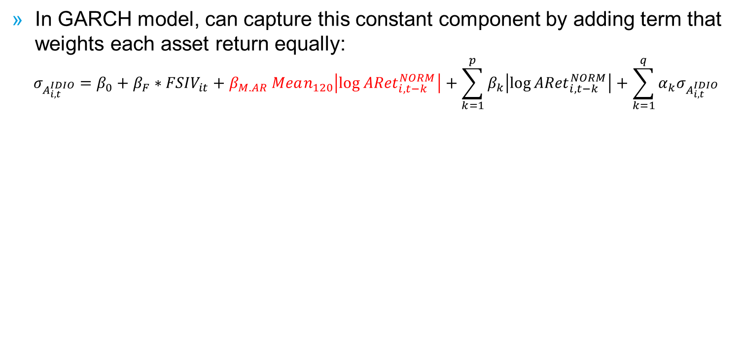
Empirical Volatility ARCH models
  In GARCH model, can capture this constant component by adding term that weights each asset return equally:
  $$σ_{A_{i,t}^{IDIO}}={β_{0}+β_{F}∗FSIV}_{it}+β_{M.AR} Mean_{120}\left|log⁡{ARet}_{i,t−k}^{NORM}\right|+\sum_{k=1}^{p}{β_{k}\left|log⁡{ARet}_{i,t−k}^{NORM}\right|}+\sum_{k=1}^{q}{α_{k}σ_{A_{i,t}^{IDIO}}}$$

Slide 15
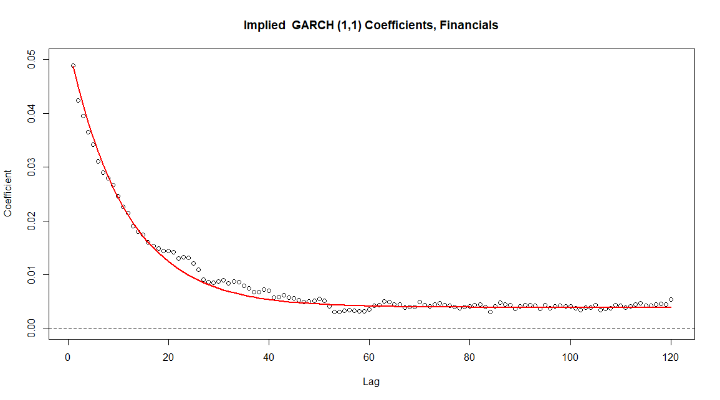
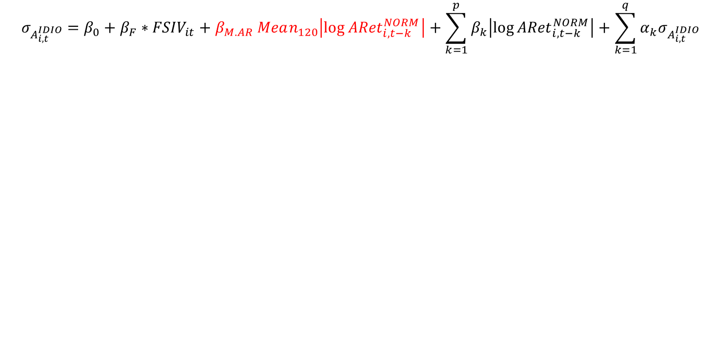
Empirical Model With Extra Term
  $$σ_{A_{i,t}^{IDIO}}={β_{0}+β_{F}∗FSIV}_{it}+β_{M.AR} Mean_{120}\left|log⁡{ARet}_{i,t−k}^{NORM}\right|+\sum_{k=1}^{p}{β_{k}\left|log⁡{ARet}_{i,t−k}^{NORM}\right|}+\sum_{k=1}^{q}{α_{k}σ_{A_{i,t}^{IDIO}}}$$

Slide 16
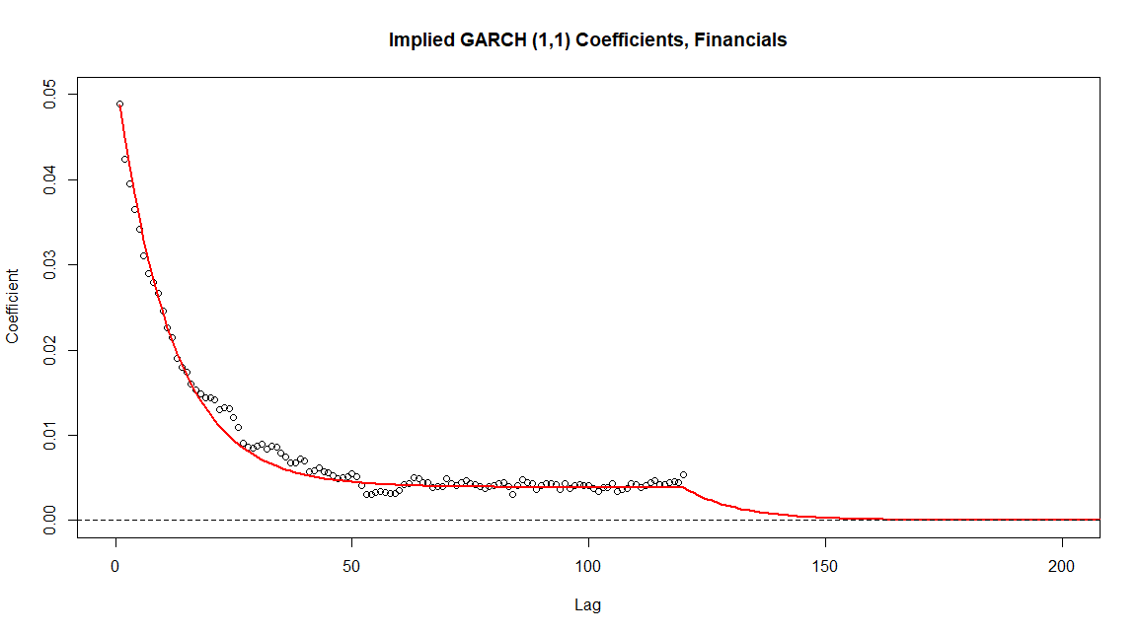
Empirical Model With Extra Term
  $$σ_{A_{i,t}^{IDIO}}={β_{0}+β_{F}∗FSIV}_{it}+β_{M.AR} Mean_{120}\left|log⁡{ARet}_{i,t−k}^{NORM}\right|+\sum_{k=1}^{p}{β_{k}\left|log⁡{ARet}_{i,t−k}^{NORM}\right|}+\sum_{k=1}^{q}{α_{k}σ_{A_{i,t}^{IDIO}}}$$

Slide 17
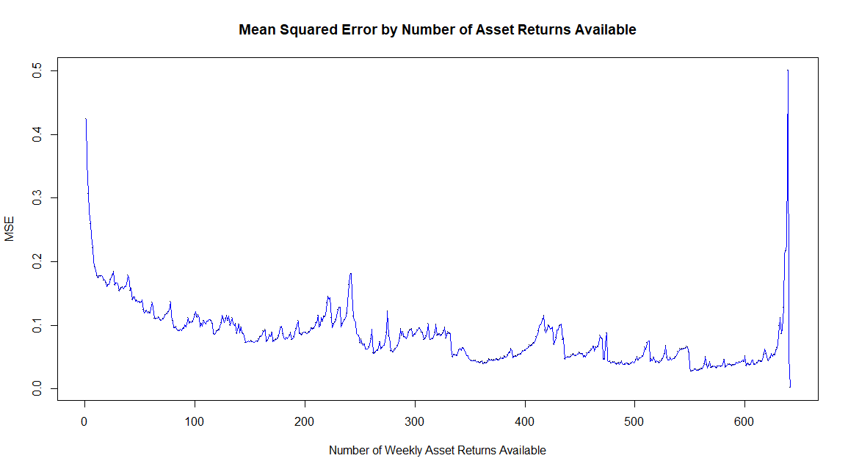
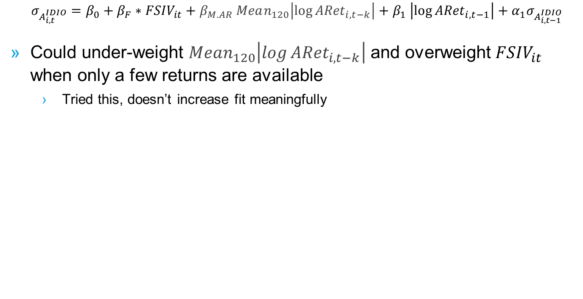
Weighting when we don’t have full history available?
  $$σ_{A_{i,t}^{IDIO}}={β_{0}+β_{F}∗FSIV}_{it}+β_{M.AR} Mean_{120}\left|log⁡{ARet}_{i,t−k}\right|+β_{1} \left|log⁡{ARet}_{i,t−1}\right|+α_{1}σ_{A_{i,t−1}^{IDIO}}$$
  Could under-weight $Mean_{120}\left|log⁡{ARet}_{i,t−k}\right|$ and overweight ${FSIV}_{it}$ when only a few returns are available
      Tried this, doesn’t increase fit meaningfully

Slide 18
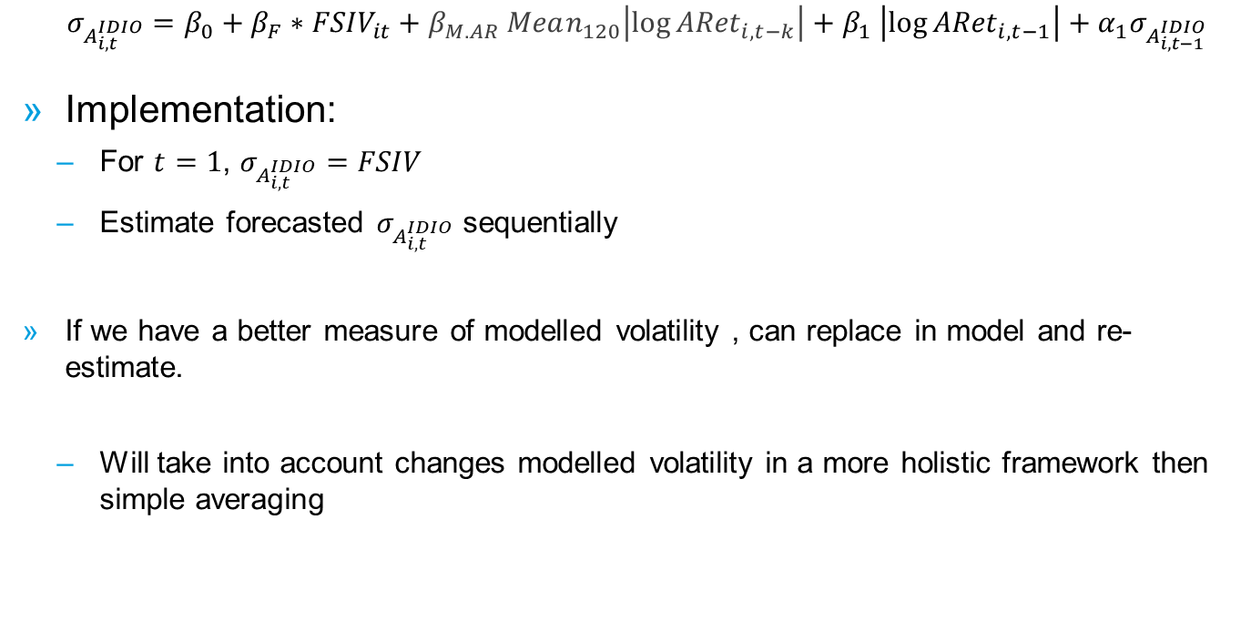
GARCH (1,1) is a “Complete” Model
  $$σ_{A_{i,t}^{IDIO}}={β_{0}+β_{F}∗FSIV}_{it}+β_{M.AR} Mean_{120}\left|log⁡{ARet}_{i,t−k}\right|+β_{1} \left|log⁡{ARet}_{i,t−1}\right|+α_{1}σ_{A_{i,t−1}^{IDIO}}$$
  Implementation:
    For $t=1$, $σ_{A_{i,t}^{IDIO}}=FSIV$
    Estimate forecasted $σ_{A_{i,t}^{IDIO}}$ sequentially
  If we have a better measure of modelled volatility , can replace in model and re-estimate.
    Will take into account changes modelled volatility in a more holistic framework then simple averaging

Slide 19
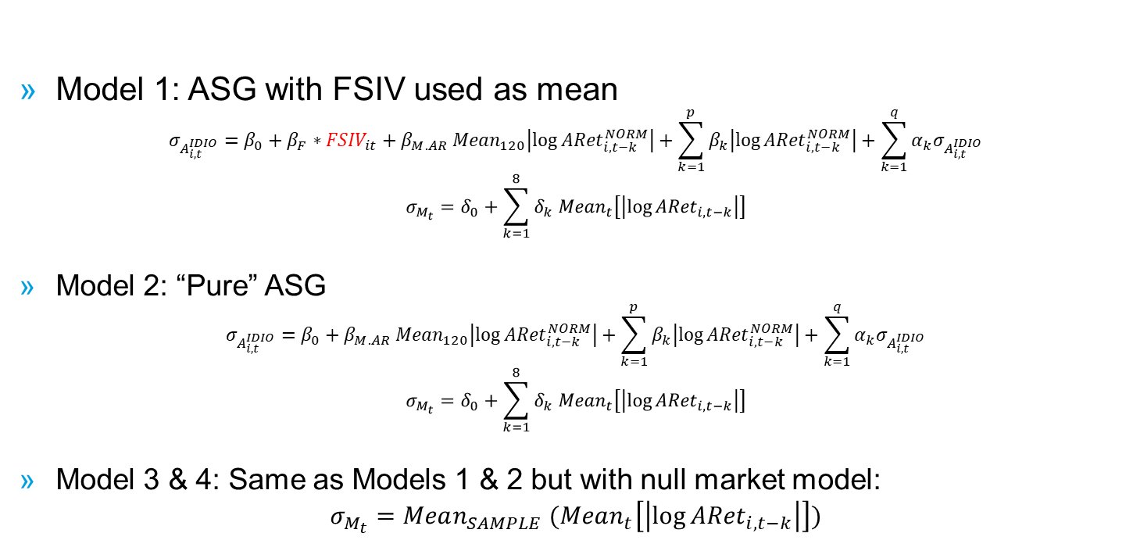
What I will be providing to Michael
  Model 1: ASG with FSIV used as mean
  $$σ_{A_{i,t}^{IDIO}}={β_{0}+β_{F}∗FSIV}_{it}+β_{M.AR} Mean_{120}\left|log⁡{ARet}_{i,t−k}^{NORM}\right|+\sum_{k=1}^{p}{β_{k}\left|log⁡{ARet}_{i,t−k}^{NORM}\right|}+\sum_{k=1}^{q}{α_{k}σ_{A_{i,t}^{IDIO}}}$$
  $$σ_{M_{t}}=δ_{0}+\sum_{k=1}^{8}{δ_{k}{ Mean}_{t}\left[\left|\log{{ARet}_{i,t−k}}\right|\right]}$$
  Model 2: “Pure” ASG
  $$σ_{A_{i,t}^{IDIO}}=β_{0}+β_{M.AR} Mean_{120}\left|log⁡{ARet}_{i,t−k}^{NORM}\right|+\sum_{k=1}^{p}{β_{k}\left|log⁡{ARet}_{i,t−k}^{NORM}\right|}+\sum_{k=1}^{q}{α_{k}σ_{A_{i,t}^{IDIO}}}$$
  $$σ_{M_{t}}=δ_{0}+\sum_{k=1}^{8}{δ_{k}{ Mean}_{t}\left[\left|\log{{ARet}_{i,t−k}}\right|\right]}$$
  Model 3 & 4: Same as Models 1 & 2 but with null market model:
  $$σ_{M_{t}}=Mean_{SAMPLE}{ (Mean}_{t}\left[\left|\log{{ARet}_{i,t−k}}\right|\right])$$

Slide 20
Equivalent GARCH Models
  Below I show the MSE of different order models vs the optimal ARCH(q) model:
CORPORATES
 | Q
 |  | 1 | 2 | 3 | 4 | 5
P | 1 | 102.56% | 102.36% | 102.30% | 102.25% | 102.24%
 | 2 | 102.30% | 102.22% | 102.23% | 102.19% | 102.19%
 | 3 | 102.20% | 102.19% | 102.11% | 102.12% | 102.14%
 | 4 | 102.13% | 102.12% | 102.10% | 102.04% | 102.09%
 | 5 | 102.09% | 102.09% | 102.09% | 102.07% | 102.01%
FINANCIALS
 | Q
 |  | 1 | 2 | 3 | 4 | 5
P | 1 | 102.98% | 102.39% | 102.22% | 102.04% | 101.92%
 | 2 | 102.25% | 102.07% | 102.07% | 101.91% | 101.82%
 | 3 | 102.04% | 102.01% | 101.83% | 101.78% | 101.71%
 | 4 | 101.81% | 101.78% | 101.72% | 101.56% | 101.57%
 | 5 | 101.63% | 101.62% | 101.57% | 101.51% | 101.22%

Slide 21
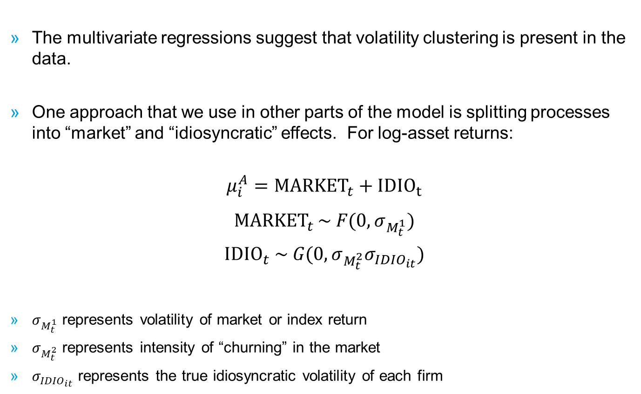
Theoretical Model of Volatility Process
  The multivariate regressions suggest that volatility clustering is present in the data.
  One approach that we use in other parts of the model is splitting processes into “market” and “idiosyncratic” effects. For log-asset returns:
  $$μ_{i}^{A}={MARKET}_{t}+{IDIO}_{t}$$
  $${MARKET}_{t }\sim F(0,σ_{M_{t}^{1}})$$
  $${IDIO}_{t} \sim G(0,σ_{M_{t}^{2}}σ_{{IDIO}_{it}})$$
  $σ_{M_{t}^{1}}$ represents volatility of market or index return
  $σ_{M_{t}^{2}}$ represents intensity of “churning” in the market
  $σ_{{IDIO}_{it}}$ represents the true idiosyncratic volatility of each firm

Slide 22
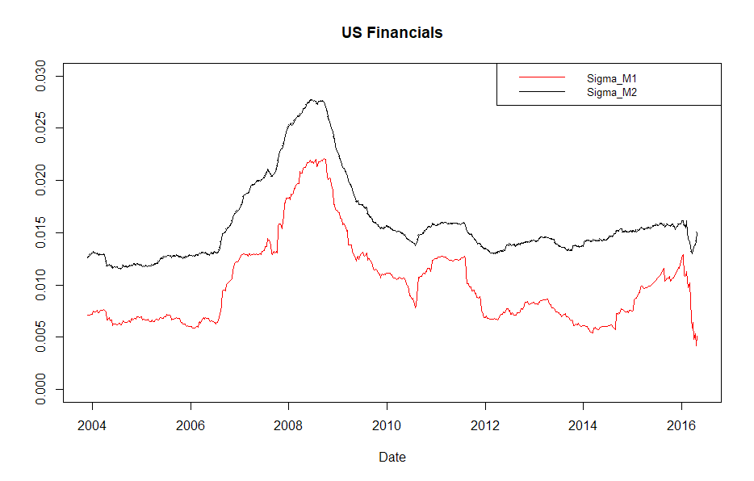
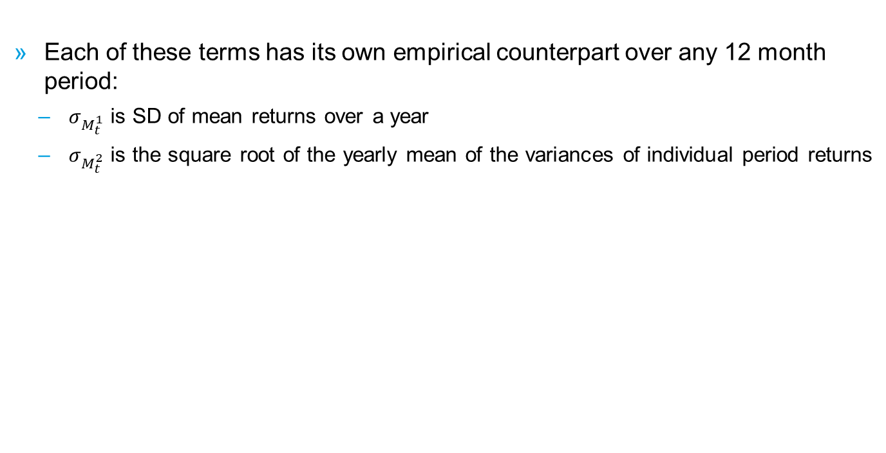
Theoretical Model of Volatility Process
  Each of these terms has its own empirical counterpart over any 12 month period:
    $σ_{M_{t}^{1}}$ is SD of mean returns over a year
    $σ_{M_{t}^{2}}$ is the square root of the yearly mean of the variances of individual period returns

Slide 23
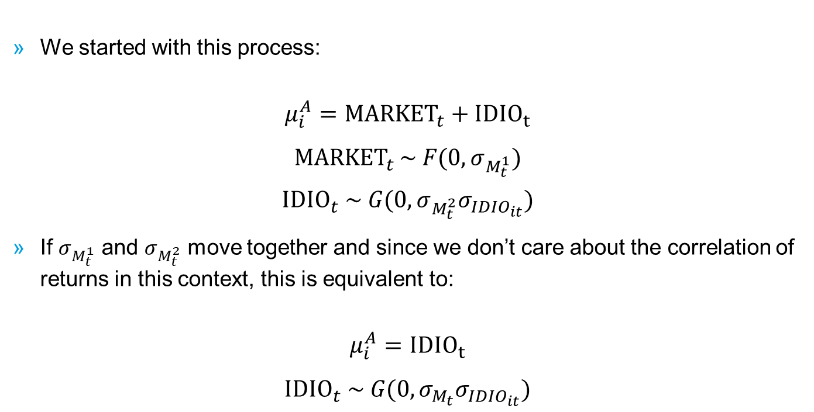
Theoretical Model of Volatility Process
  We started with this process:
  $$μ_{i}^{A}={MARKET}_{t}+{IDIO}_{t}$$
  $${MARKET}_{t }\sim F(0,σ_{M_{t}^{1}})$$
  $${IDIO}_{t} \sim G(0,σ_{M_{t}^{2}}σ_{{IDIO}_{it}})$$
  If $σ_{M_{t}^{1}}$ and $σ_{M_{t}^{2}}$ move together and since we don’t care about the correlation of returns in this context, this is equivalent to:
  $$μ_{i}^{A}={IDIO}_{t}$$
  $${IDIO}_{t} \sim G(0,σ_{M_{t}}σ_{{IDIO}_{it}})$$

Slide 24
© 2018 Moody’s Corporation, Moody’s Investors Service, Inc., Moody’s Analytics, Inc. and/or their licensors and affiliates (collectively, “MOODY’S”). All rights reserved.
CREDIT RATINGS ISSUED BY MOODY'S INVESTORS SERVICE, INC. AND ITS RATINGS AFFILIATES (“MIS”) ARE MOODY’S CURRENT OPINIONS OF THE RELATIVE FUTURE CREDIT RISK OF ENTITIES, CREDIT COMMITMENTS, OR DEBT OR DEBT-LIKE SECURITIES, AND MOODY’S PUBLICATIONS MAY INCLUDE MOODY’S CURRENT OPINIONS OF THE RELATIVE FUTURE CREDIT RISK OF ENTITIES, CREDIT COMMITMENTS, OR DEBT OR DEBT-LIKE SECURITIES. MOODY’S DEFINES CREDIT RISK AS THE RISK THAT AN ENTITY MAY NOT MEET ITS CONTRACTUAL, FINANCIAL OBLIGATIONS AS THEY COME DUE AND ANY ESTIMATED FINANCIAL LOSS IN THE EVENT OF DEFAULT. CREDIT RATINGS DO NOT ADDRESS ANY OTHER RISK, INCLUDING BUT NOT LIMITED TO: LIQUIDITY RISK, MARKET VALUE RISK, OR PRICE VOLATILITY. CREDIT RATINGS AND MOODY’S OPINIONS INCLUDED IN MOODY’S PUBLICATIONS ARE NOT STATEMENTS OF CURRENT OR HISTORICAL FACT. MOODY’S PUBLICATIONS MAY ALSO INCLUDE QUANTITATIVE MODEL-BASED ESTIMATES OF CREDIT RISK AND RELATED OPINIONS OR COMMENTARY PUBLISHED BY MOODY’S ANALYTICS, INC. CREDIT RATINGS AND MOODY’S PUBLICATIONS DO NOT CONSTITUTE OR PROVIDE INVESTMENT OR FINANCIAL ADVICE, AND CREDIT RATINGS AND MOODY’S PUBLICATIONS ARE NOT AND DO NOT PROVIDE RECOMMENDATIONS TO PURCHASE, SELL, OR HOLD PARTICULAR SECURITIES. NEITHER CREDIT RATINGS NOR MOODY’S PUBLICATIONS COMMENT ON THE SUITABILITY OF AN INVESTMENT FOR ANY PARTICULAR INVESTOR. MOODY’S ISSUES ITS CREDIT RATINGS AND PUBLISHES MOODY’S PUBLICATIONS WITH THE EXPECTATION AND UNDERSTANDING THAT EACH INVESTOR WILL, WITH DUE CARE, MAKE ITS OWN STUDY AND EVALUATION OF EACH SECURITY THAT IS UNDER CONSIDERATION FOR PURCHASE, HOLDING, OR SALE.
MOODY’S CREDIT RATINGS AND MOODY’S PUBLICATIONS ARE NOT INTENDED FOR USE BY RETAIL INVESTORS AND IT WOULD BE RECKLESS AND INAPPROPRIATE FOR RETAIL INVESTORS TO USE MOODY’S CREDIT RATINGS OR MOODY’S PUBLICATIONS WHEN MAKING AN INVESTMENT DECISION. IF IN DOUBT YOU SHOULD CONTACT YOUR FINANCIAL OR OTHER PROFESSIONAL ADVISER.
ALL INFORMATION CONTAINED HEREIN IS PROTECTED BY LAW, INCLUDING BUT NOT LIMITED TO, COPYRIGHT LAW, AND NONE OF SUCH INFORMATION MAY BE COPIED OR OTHERWISE REPRODUCED, REPACKAGED, FURTHER TRANSMITTED, TRANSFERRED, DISSEMINATED, REDISTRIBUTED OR RESOLD, OR STORED FOR SUBSEQUENT USE FOR ANY SUCH PURPOSE, IN WHOLE OR IN PART, IN ANY FORM OR MANNER OR BY ANY MEANS WHATSOEVER, BY ANY PERSON WITHOUT MOODY’S PRIOR WRITTEN CONSENT.
CREDIT RATINGS AND MOODY’S PUBLICATIONS ARE NOT INTENDED FOR USE BY ANY PERSON AS A BENCHMARK AS THAT TERM IS DEFINED FOR REGULATORY PURPOSES AND MUST NOT BE USED IN ANY WAY THAT COULD RESULT IN THEM BEING CONSIDERED A BENCHMARK.
All information contained herein is obtained by MOODY’S from sources believed by it to be accurate and reliable. Because of the possibility of human or mechanical error as well as other factors, however, all information contained herein is provided “AS IS” without warranty of any kind. MOODY'S adopts all necessary measures so that the information it uses in assigning a credit rating is of sufficient quality and from sources MOODY'S considers to be reliable including, when appropriate, independent third-party sources. However, MOODY’S is not an auditor and cannot in every instance independently verify or validate information received in the rating process or in preparing the Moody’s publications.
To the extent permitted by law, MOODY’S and its directors, officers, employees, agents, representatives, licensors and suppliers disclaim liability to any person or entity for any indirect, special, consequential, or incidental losses or damages whatsoever arising from or in connection with the information contained herein or the use of or inability to use any such information, even if MOODY’S or any of its directors, officers, employees, agents, representatives, licensors or suppliers is advised in advance of the possibility of such losses or damages, including but not limited to: (a) any loss of present or prospective profits or (b) any loss or
damage arising where the relevant financial instrument is not the subject of a particular credit rating assigned
by MOODY’S.
To the extent permitted by law, MOODY’S and its directors, officers, employees, agents, representatives, licensors and suppliers disclaim liability for any direct or compensatory losses or damages caused to any person or entity, including but not limited to by any negligence (but excluding fraud, willful misconduct or any other type of liability that, for the avoidance of doubt, by law cannot be excluded) on the part of, or any contingency within or beyond the control of, MOODY’S or any of its directors, officers, employees, agents, representatives, licensors or suppliers, arising from or in connection with the information contained herein or the use of or inability to use any such information.
NO WARRANTY, EXPRESS OR IMPLIED, AS TO THE ACCURACY, TIMELINESS, COMPLETENESS, MERCHANTABILITY OR FITNESS FOR ANY PARTICULAR PURPOSE OF ANY SUCH RATING OR OTHER OPINION OR INFORMATION IS GIVEN OR MADE BY MOODY’S IN ANY FORM OR MANNER WHATSOEVER.
Moody’s Investors Service, Inc., a wholly-owned credit rating agency subsidiary of Moody’s Corporation (“MCO”), hereby discloses that most issuers of debt securities (including corporate and municipal bonds, debentures, notes and commercial paper) and preferred stock rated by Moody’s Investors Service, Inc. have, prior to assignment of any rating, agreed to pay to Moody’s Investors Service, Inc. for appraisal and rating services rendered by it fees ranging from $1,500 to approximately $2,500,000. MCO and MIS also maintain policies and procedures to address the independence of MIS’s ratings and rating processes. Information regarding certain affiliations that may exist between directors of MCO and rated entities, and between entities who hold ratings from MIS and have also publicly reported to the SEC an ownership interest in MCO of more than 5%, is posted annually at www.moodys.com under the heading “Investor Relations — Corporate Governance — Director and Shareholder Affiliation Policy.”
Additional terms for Australia only: Any publication into Australia of this document is pursuant to the Australian Financial Services License of MOODY’S affiliate, Moody’s Investors Service Pty Limited ABN 61 003 399 657AFSL 336969 and/or Moody’s Analytics Australia Pty Ltd ABN 94 105 136 972 AFSL 383569 (as applicable). This document is intended to be provided only to “wholesale clients” within the meaning of section 761G of the Corporations Act 2001. By continuing to access this document from within Australia, you represent to MOODY’S that you are, or are accessing the document as a representative of, a “wholesale client” and that neither you nor the entity you represent will directly or indirectly disseminate this document or its contents to “retail clients” within the meaning of section 761G of the Corporations Act 2001. MOODY’S credit rating is an opinion as to the creditworthiness of a debt obligation of the issuer, not on the equity securities of the issuer or any form of security that is available to retail investors. It would be reckless and inappropriate for retail investors to use MOODY’S credit ratings or publications when making an investment decision. If in doubt you should contact your financial or other professional adviser.
Additional terms for Japan only: Moody's Japan K.K. (“MJKK”) is a wholly-owned credit rating agency subsidiary of Moody's Group Japan G.K., which is wholly-owned by Moody’s Overseas Holdings Inc., a wholly-owned subsidiary of MCO. Moody’s SF Japan K.K. (“MSFJ”) is a wholly-owned credit rating agency subsidiary of MJKK. MSFJ is not a Nationally Recognized Statistical Rating Organization (“NRSRO”). Therefore, credit ratings assigned by MSFJ are Non-NRSRO Credit Ratings. Non-NRSRO Credit Ratings are assigned by an entity that is not a NRSRO and, consequently, the rated obligation will not qualify for certain types of treatment under U.S. laws. MJKK and MSFJ are credit rating agencies registered with the Japan Financial Services Agency and their registration numbers are FSA Commissioner (Ratings) No. 2 and 3 respectively.
MJKK or MSFJ (as applicable) hereby disclose that most issuers of debt securities (including corporate and municipal bonds, debentures, notes and commercial paper) and preferred stock rated by MJKK or MSFJ (as applicable) have, prior to assignment of any rating, agreed to pay to MJKK or MSFJ (as applicable) for appraisal and rating services rendered by it fees ranging from JPY200,000 to approximately JPY350,000,000.
MJKK and MSFJ also maintain policies and procedures to address Japanese regulatory requirements.

